Slide 1


Mini Project – 1
Discrete Mathematics , CSE – 106, Sec – 3, Group NO -7 ( ODD)
Submitted To :
Prof. Dr. MD. Mozammel Huq Azad Khan
(Professor)
Group member 1 :
Name : MD. Ariful Islam Anik
ID : 2021-1-60-028
Group Member 2 :
Name : Anika Tahsin
ID : 2021-1-60-021
Group Member 3 :
Name : Al-Amin Sarker
ID : 2021-1-60-029

Slide 2


Slide 3
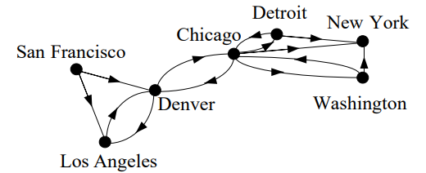
Definition of directed graph
A directed graph (or digraph) G = (V, E) consists of a nonempty set of vertices V and a set of
directed edges (or arcs) E. Each directed edge is associated with an ordered pair of vertices. The directed edge
associated with the ordered pair (u, v) is said to start at u and end at v.
In a graph with directed edges, the in-degree of a vertex denoted by deg- which is the number of edges as terminal vertex. The out-degree of a vertex denoted by deg+ which is the number of edges as initial vertex.
Final presentation slide
Md. Mozammel Huq Azad Khan, Professor, CSE, EWU

Slide 4
01
Generate a directed graph represented by adjacency matrix using c program

Slide 5
Constant Declaration
# define n 1000
Header files
#include<stdio.h>
#include<stdlib.h>
#include<time.h>
#include<string.h>

Slide 6
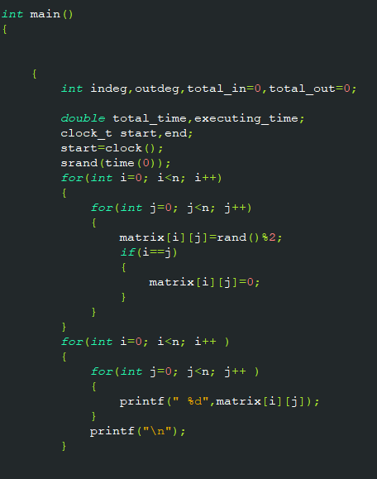
Main function part 1

Slide 7
02
Determine in degrees and out degrees of all vertices

Slide 8
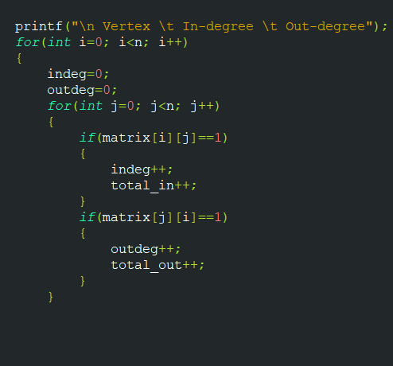
The main function part 2

Slide 9
03
Sum of in-degrees and sum of out degrees are equal

Slide 10
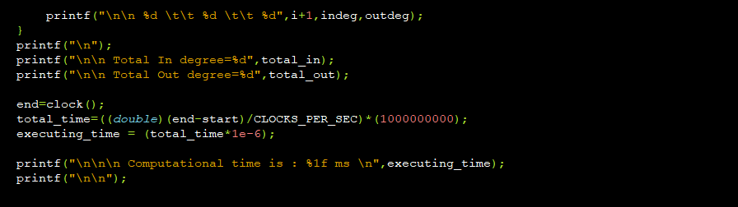
End of main function

Slide 11
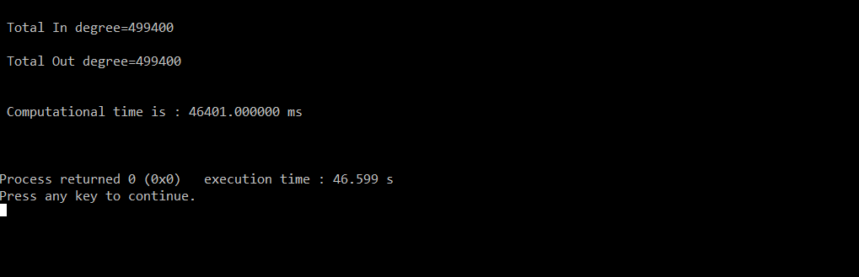
For N = 1000

Slide 12
04 Determine computational time in MILI-SECOND

Slide 13
Run the same program changing the value of the constant variable ‘n’ sequentially 2000, 3000, 4000, 5000.

Slide 14
By changing one value in the top of the program
Example
For n = 2000 . # define max 2000
For n = 3000 . # define max 3000
For n = 4000 . # define max 4000
For n = 5000 . # define max 5000

Slide 15
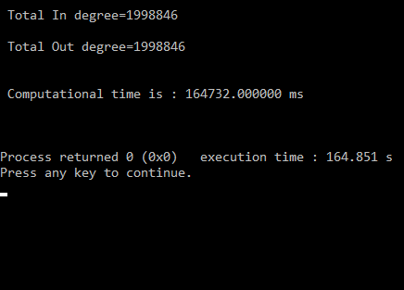
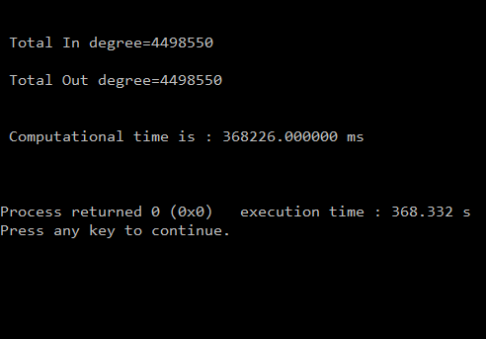
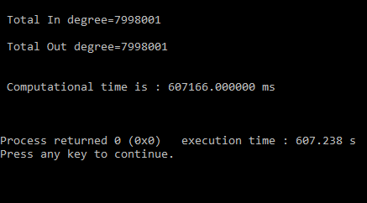
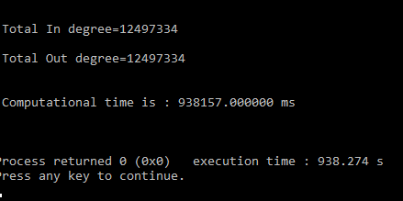
For n = 2000
For n = 3000
For n = 4000
For n = 5000

Slide 16
Computing time in Milli-second after running the program
For n = 1000 ----------- 46401 ms.
For n = 2000 ----------- 164732 ms.
For n = 3000 ----------- 368226 ms.
For n = 4000 ----------- 607166 ms.
For n = 5000 ----------- 938157 ms.

Slide 17
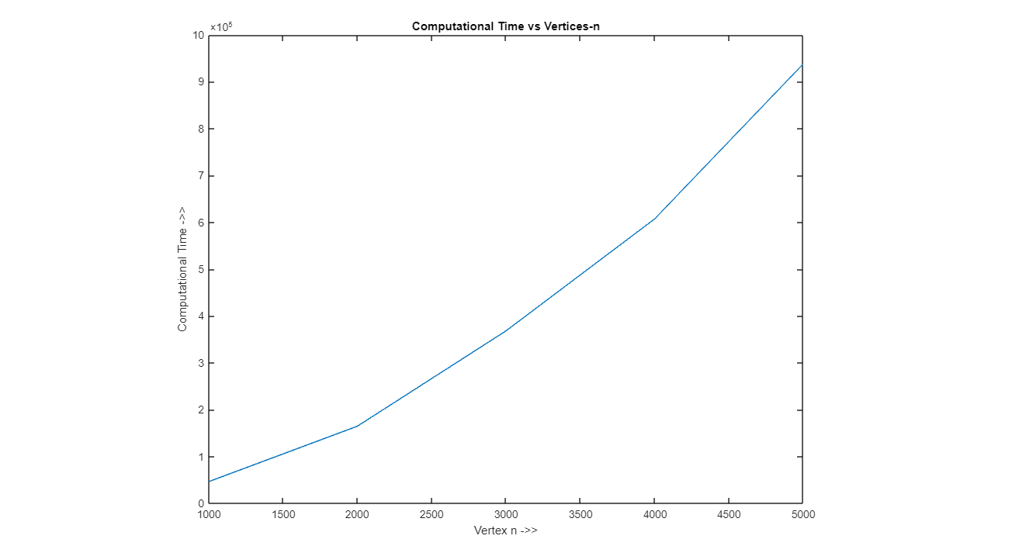
Graph of computation time vs Vertices - n

Slide 18
Time Complexity
The time complexity of an algorithm is an estimate of the time required by the algorithm to solve a problem of a particular size.
The time complexity of an algorithm can be expressed in terms of the number of operations used by the algorithm when the input has a particular size.
WORST-CASE COMPLEXITY
By the worst-case complexity of an algorithm, we mean the largest number of operations needed to solve the
given problem using this algorithm on input of specified size.
AVERAGE-CASE COMPLEXITY
In average-case complexity, the average number of operations used to solve the problem over all inputs of a
given size is found.

Slide 19



Time Complexity of the program
To generate the random directed adjacency matrix and print :
for(int i=0; i<n; i++)
{
for(int j=0; j<n; j++)
{
matrix[i][j]=rand()%2;
if(i==j)
{
matrix[i][j]=0;
}
}
}
for(int i=0; i<n; i++ )
{
for(int j=0; j<n; j++ )
{
printf(" %d",matrix[i][j]);
}
printf("\n");
}
Every time for loop will be executed for n times. In this part there are two nested for loops. To exit the loop each time one more comparison is needed. For the first nested loop,
One more comparison in 2nd for loop.
Number of Comparisons here,
$f_{1}\left(n\right)=\left(n+1\right)\left(n+2\right)= n^{2}+3n+2$ And,
For the second nested loop,
$$f_{2}\left(n\right)=\left(n+1\right)\left(n+1\right)= n^{2}+2n+1$$
$$f_{1}$$
$$f_{2}$$

Slide 20


For Counting the In-degree and out-degree of the directed adjacency matrix :
for(int i=0; i<n; i++)
{
indeg=0;
outdeg=0;
for(int j=0; j<n; j++)
{
if(matrix[i][j]==1)
{
indeg++;
total_in++;
}
if(matrix[j][i]==1)
{
outdeg++;
total_out++;
}
}
Every time for loop executes it takes n times. This is a nested loop. In the 2nd for loop two more comparisons are performed.
Number of comparisons here,
$f_{3}=\left(n+1\right)\left(n+3\right)= n^{2}+4n+3$
$$f_{3}$$

Slide 21

So the total time complexity is :
$$f\left(n\right)=f_{1}+f_{2}+f_{3}$$
$=n^{2}+3n+2+n^{2}+2n+1+n^{2}+4n+3$
$$= 3n^{2}+9n+5$$
Hence , time complexity of the program is :
$O\left(n\right)=n^{2}$
In Big O notation, the time complexity of O(n2) is known as Quadratic time complexity.

Slide 22
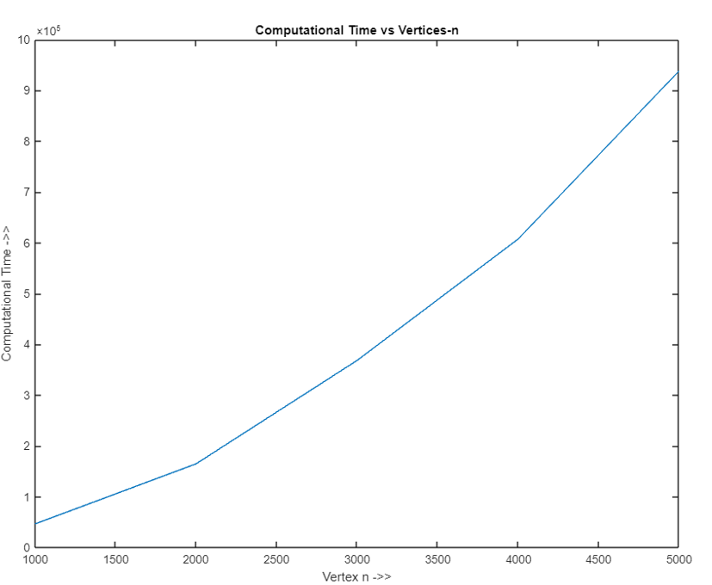
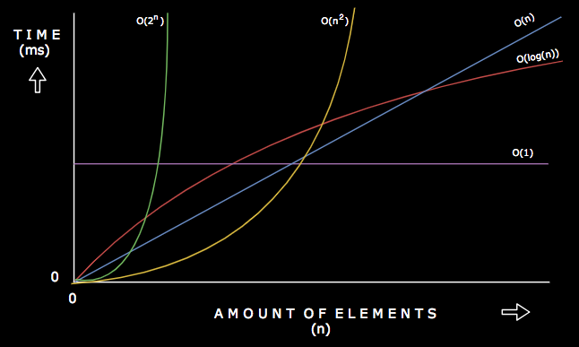

Comparison of the graphs :
Graph of computational time and vertices - n
Graph of Big O notation
Source: www.digitalocean.com/
Here the approximate time of the program is determined as a function of n by comparing it with the graph of big- O notation. We can see that the time of both the computational and the line of $O\left(n^{2}\right)$ of big-O notation graph is almost same.
So, from the graph and theoretically it can be said that the time complexity of this program is $O\left(n^{2}\right).$

Slide 23

Thank you Very much for being with us

